Slide 1
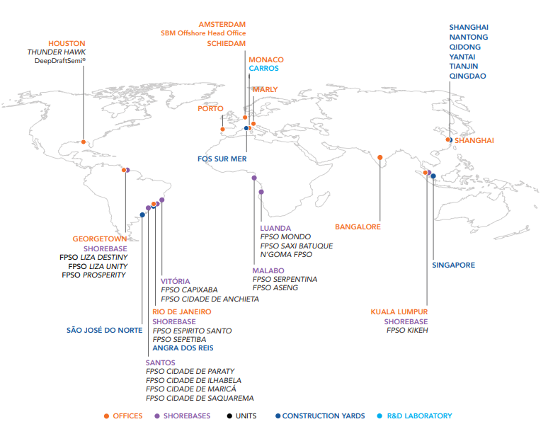
Appendix 1 - Overview of Taxes – SBM Offshore Global Presence

Slide 2
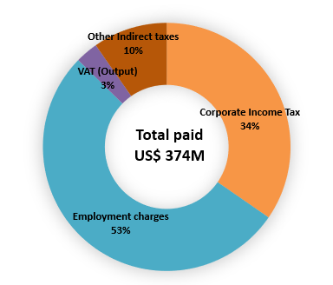
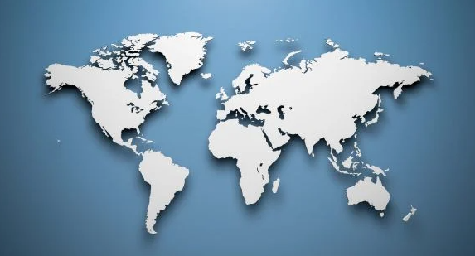
Overview of Taxes – 2023 Current Tax Liabilities (IFRS)
Corporate Tax Footprint of the Group at a Glance (in millions US$): Overall Tax Footprint of the Group (in millions US$):
Guyana
US$ 66.5
Brazil
US$ 23.8
United Kingdom
US$ 14.4
Switzerland
US$ 12.6
India
US$ 1.3
Equatorial Guinea
US$ 4.4
Monaco
US$ 1.4
Malaysia
US$ 1.1

Slide 3
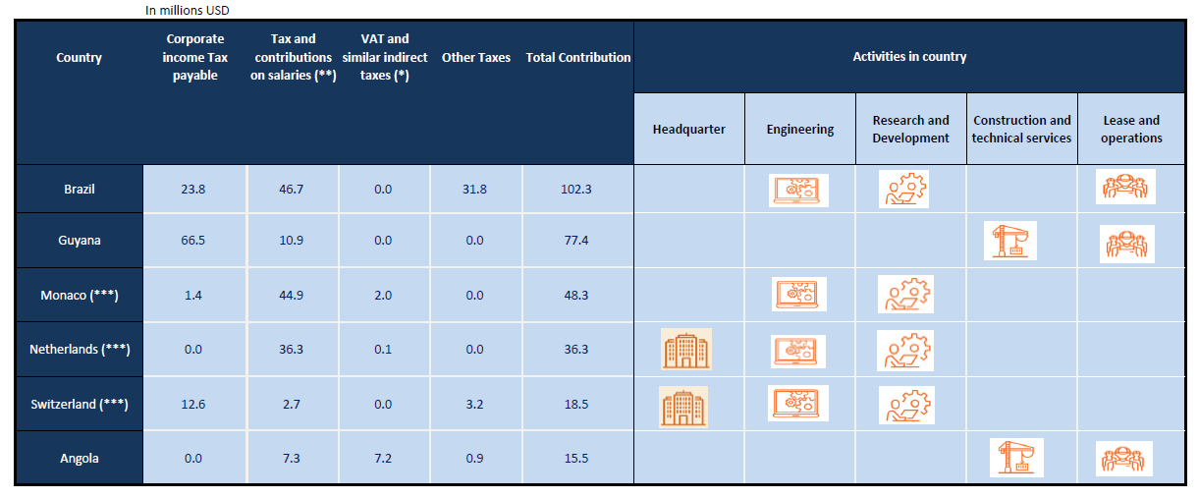
Top 10 Tax Contributions by Jurisdiction in 2023 (in millions US$) – IFRS

Slide 4
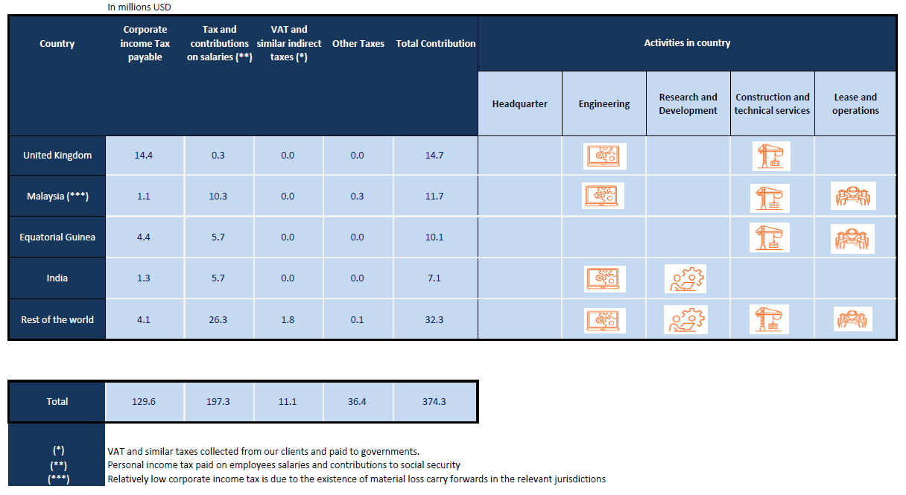
Top 10 Tax Contributions by Jurisdiction in 2023 (in millions US$) – IFRS
Focus
Tax & Contributions on salaries for « Rest of the world » US$ 26.3 includes:
China (US$ 14.1); Portugal (US$ 6.3); US (US$ 2.1); Singapore (US$ 1.8); France (US$ 0.8); Norway (US$ 0.75); Canada (US$ 0.3)

